Slide 1
P589-1: lognorm vs dsb normalization for totalseq gating, 5 and 7 cluster rna clusters
Thomas H. Edwards
20241113

Slide 2
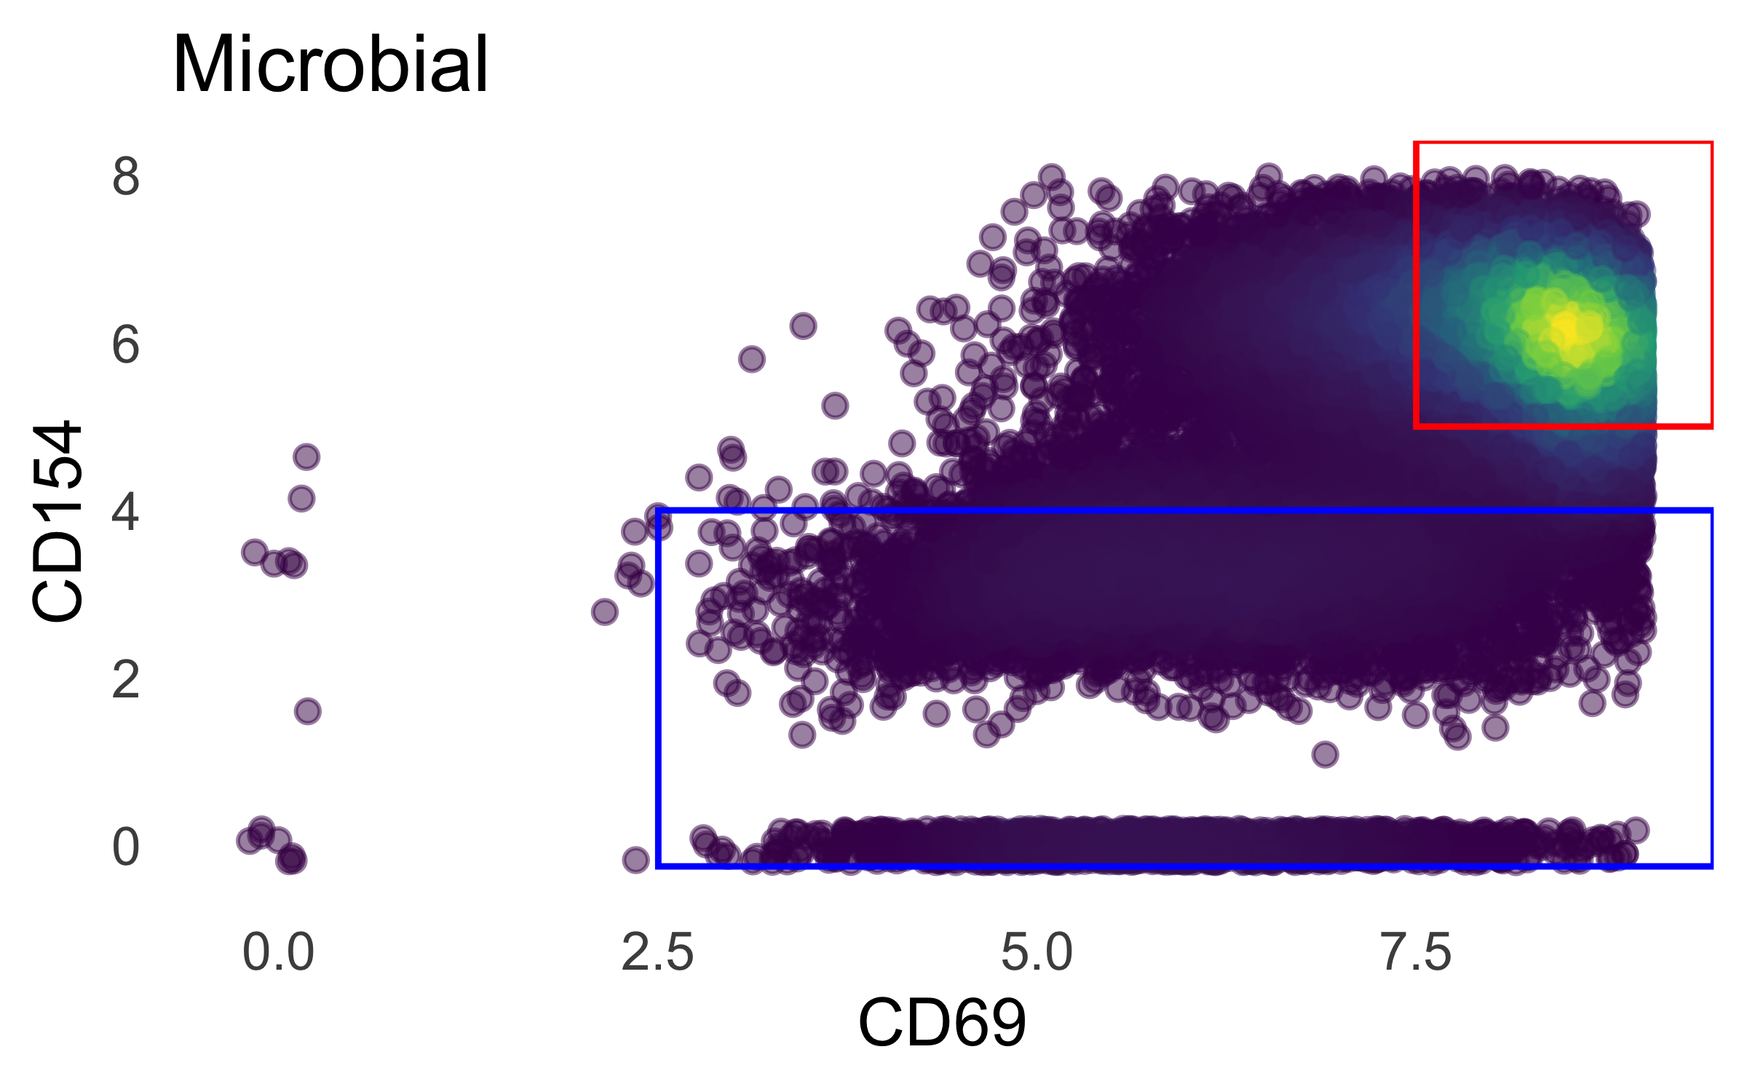
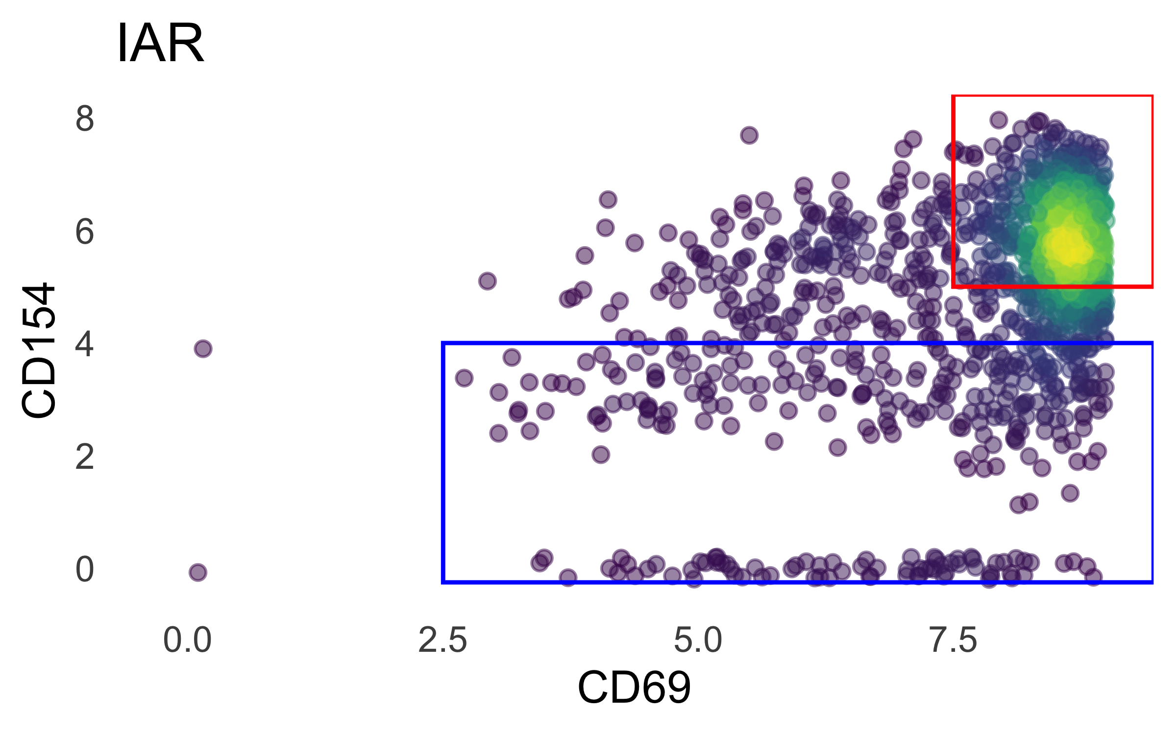
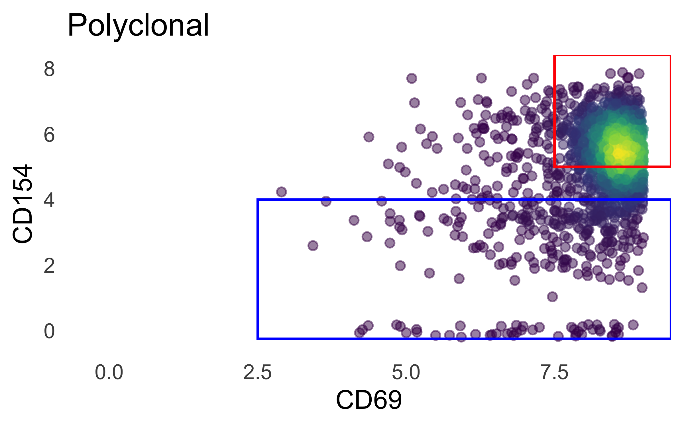
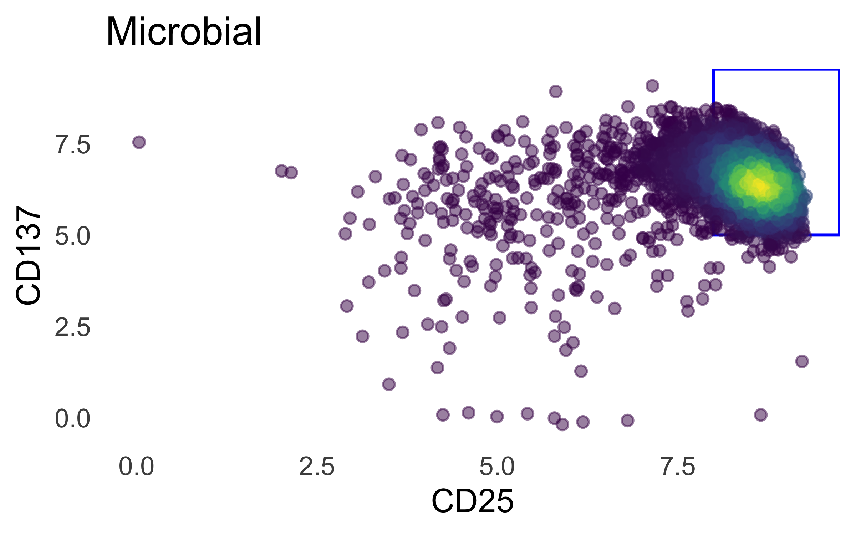
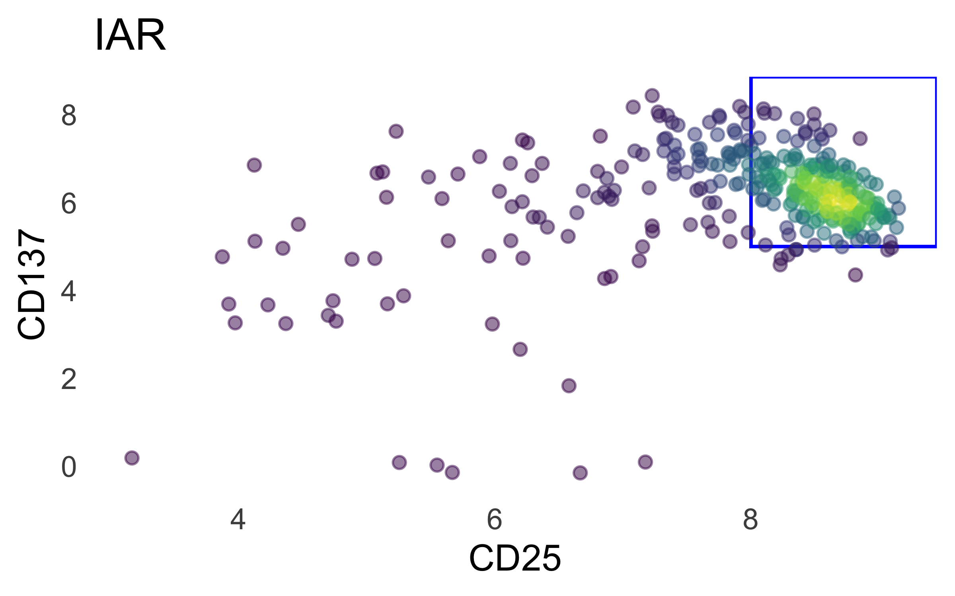
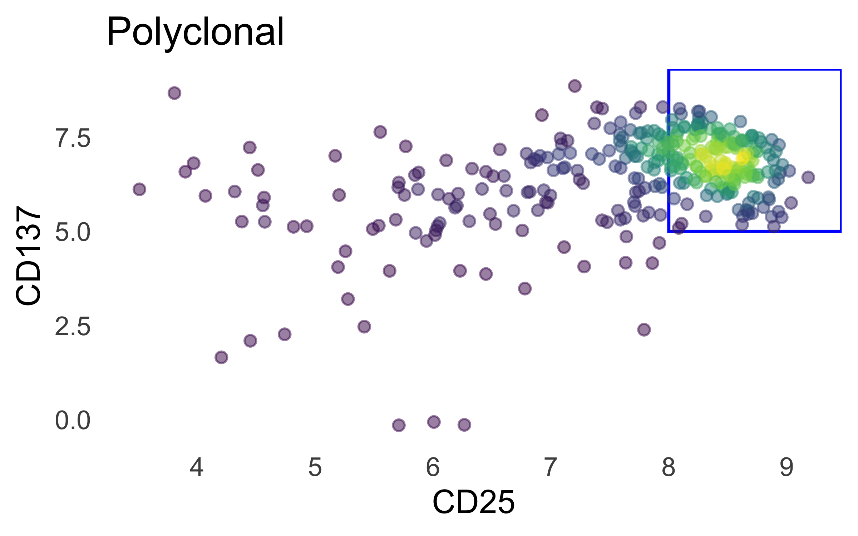
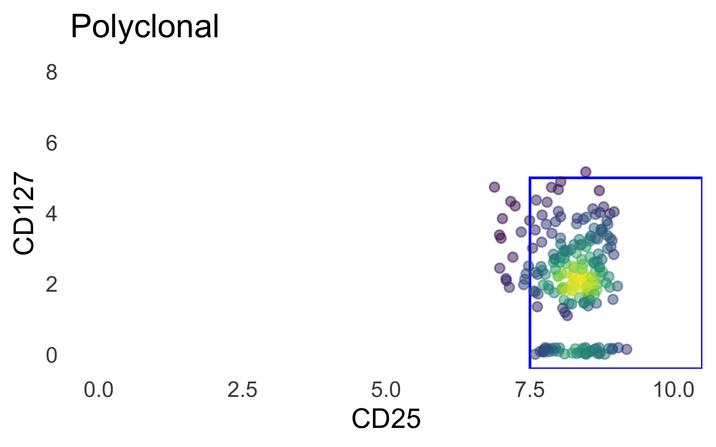
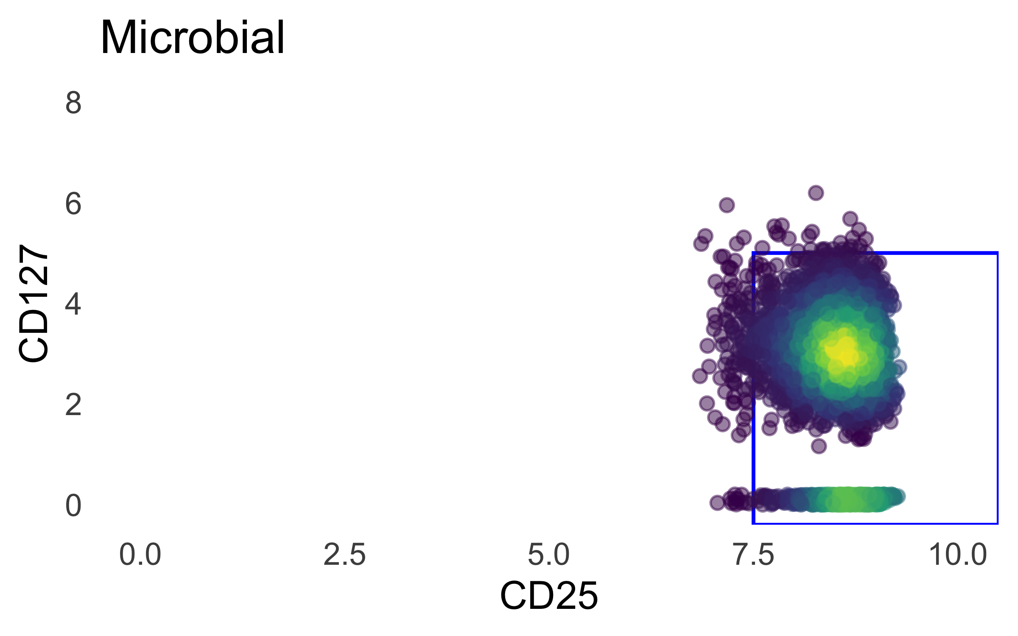
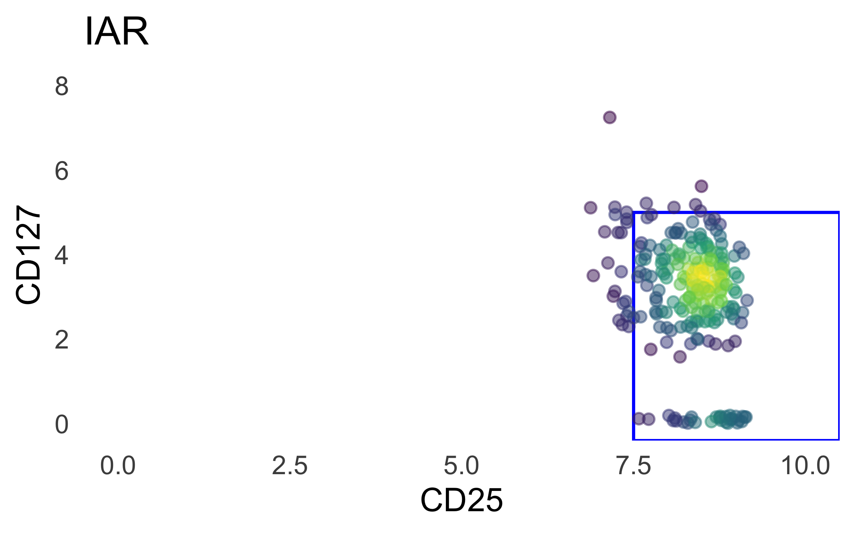
lognorm totalseq gating

Slide 3
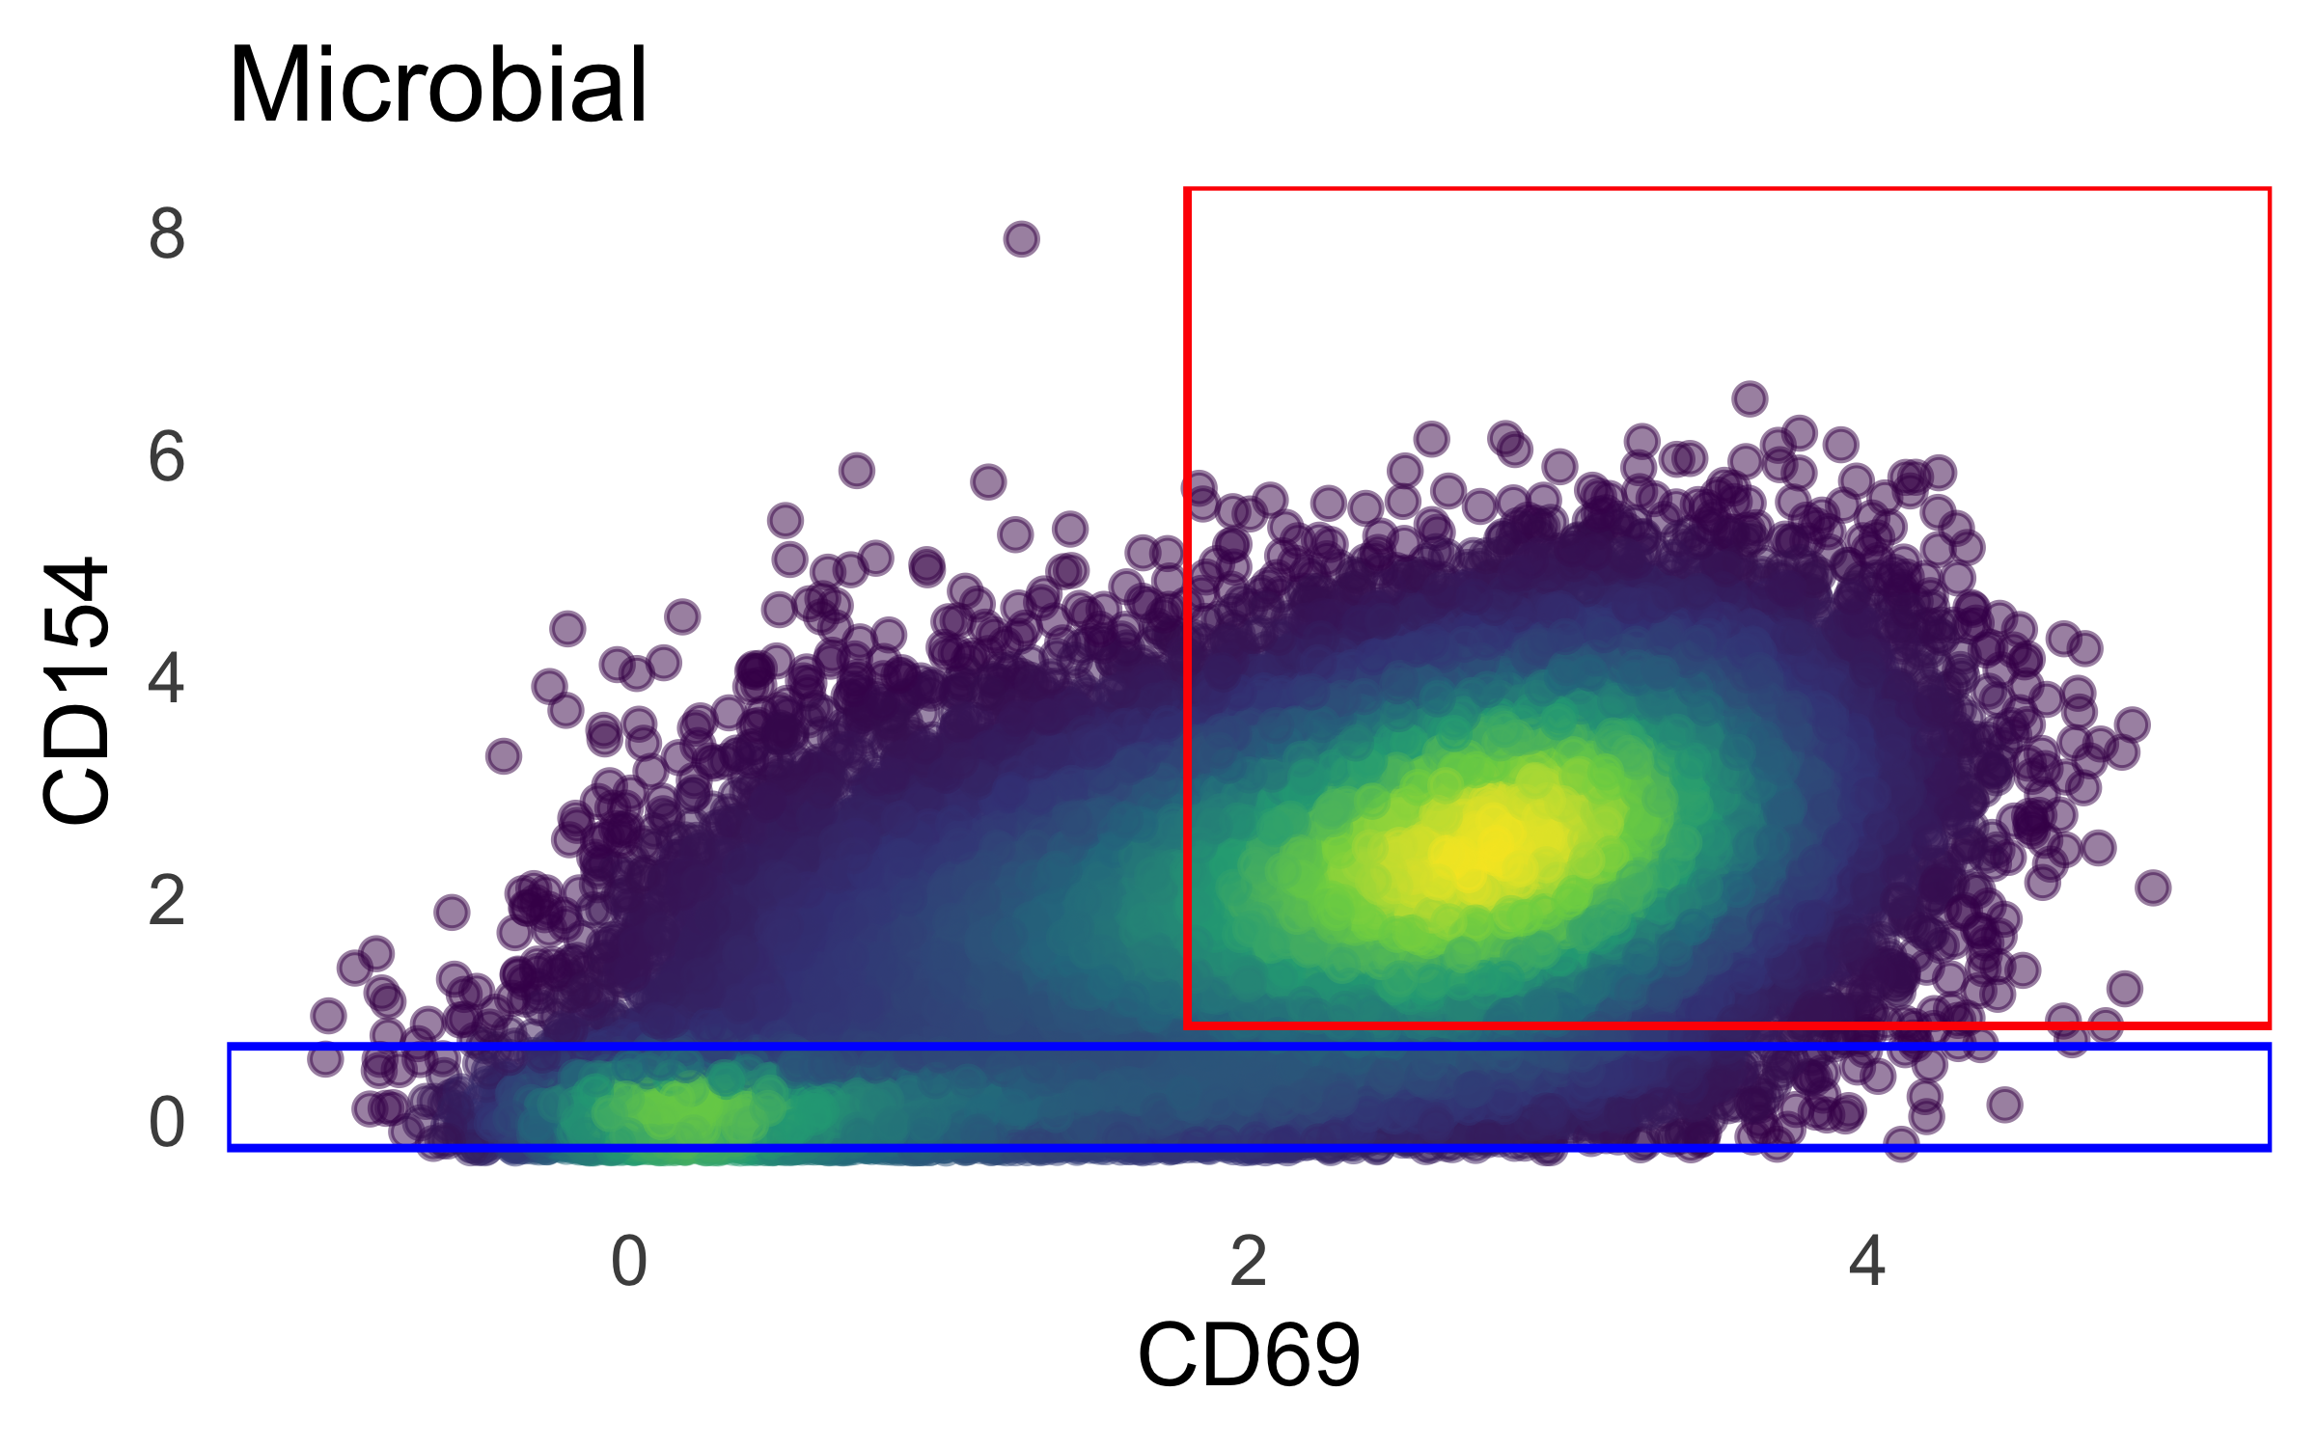
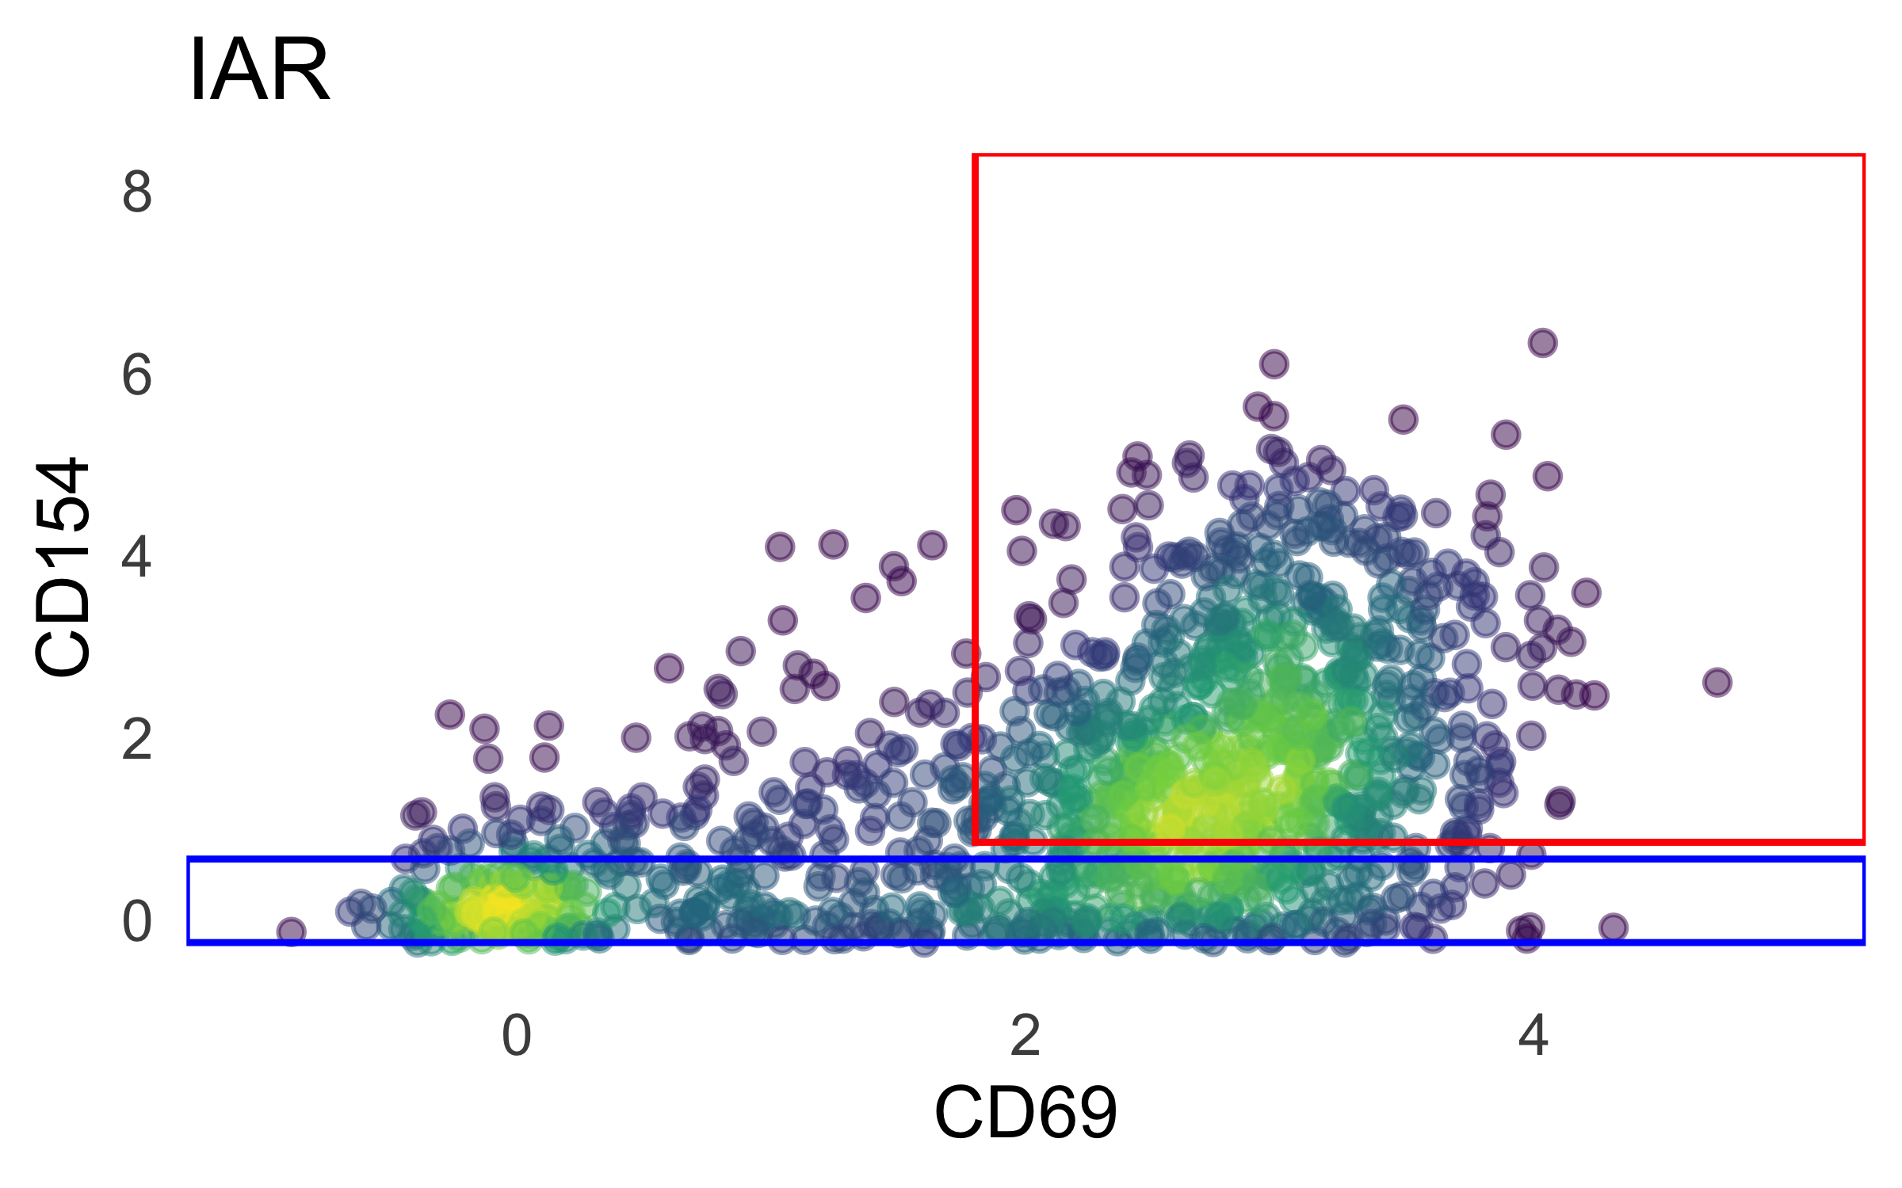
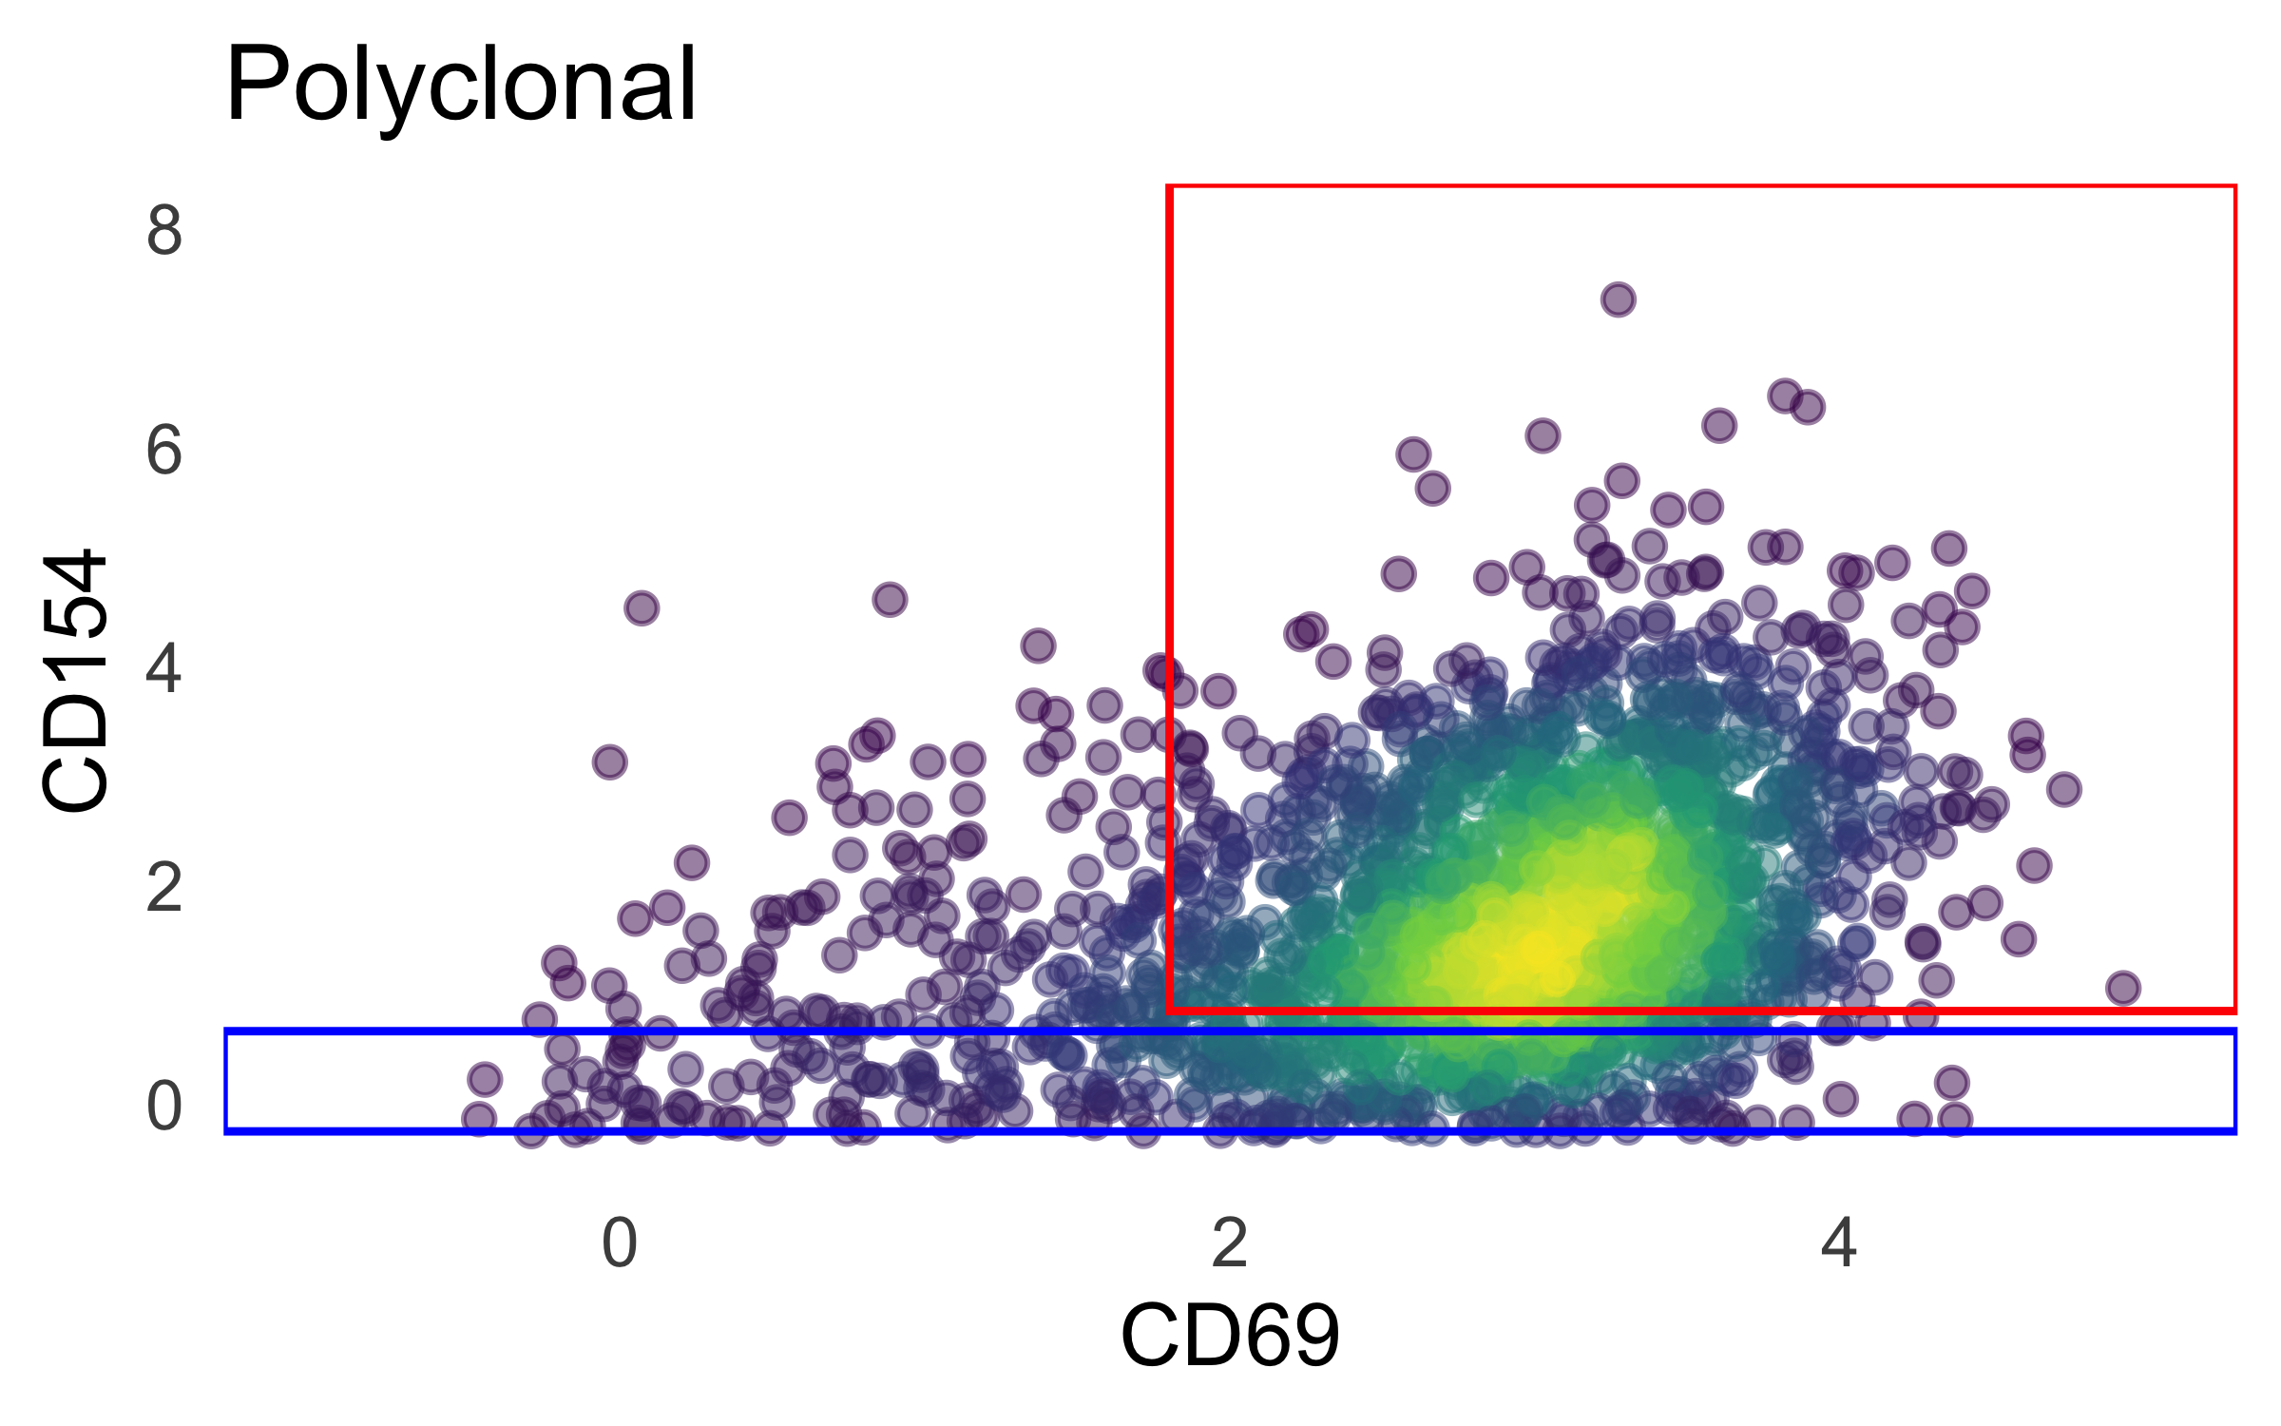
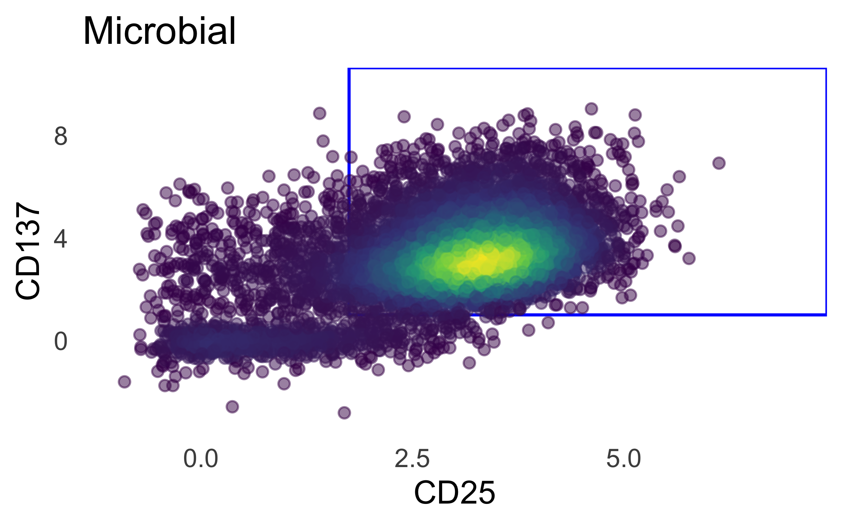
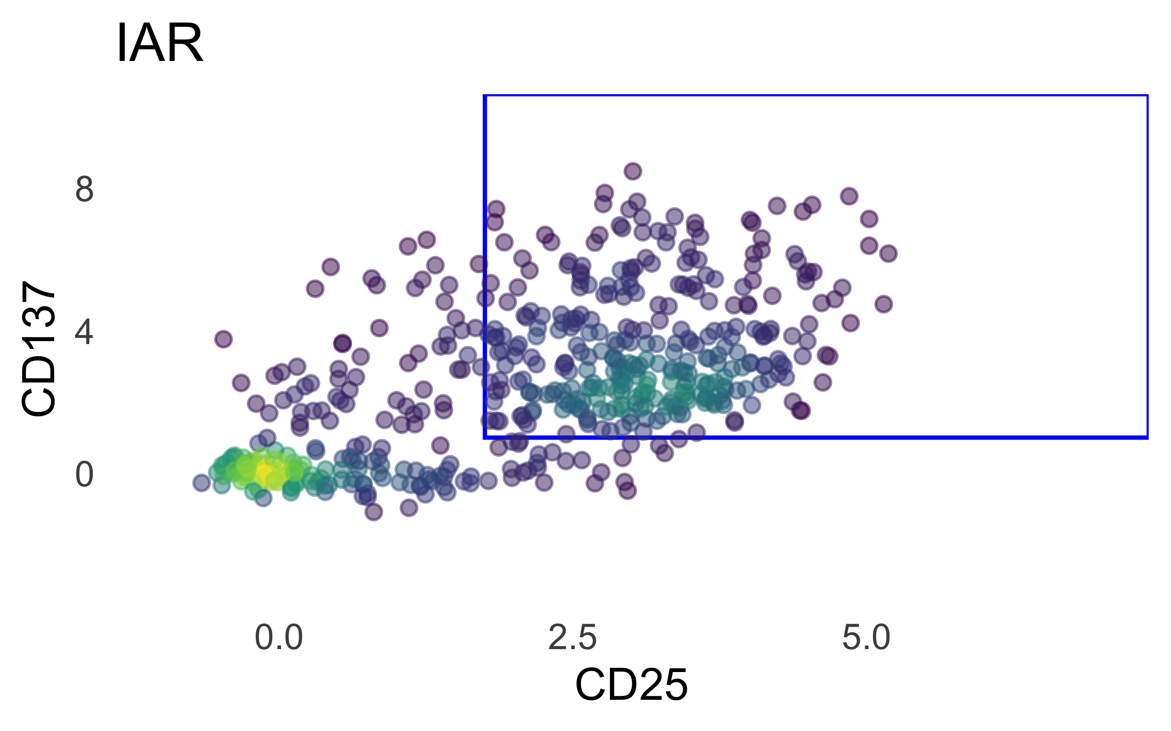
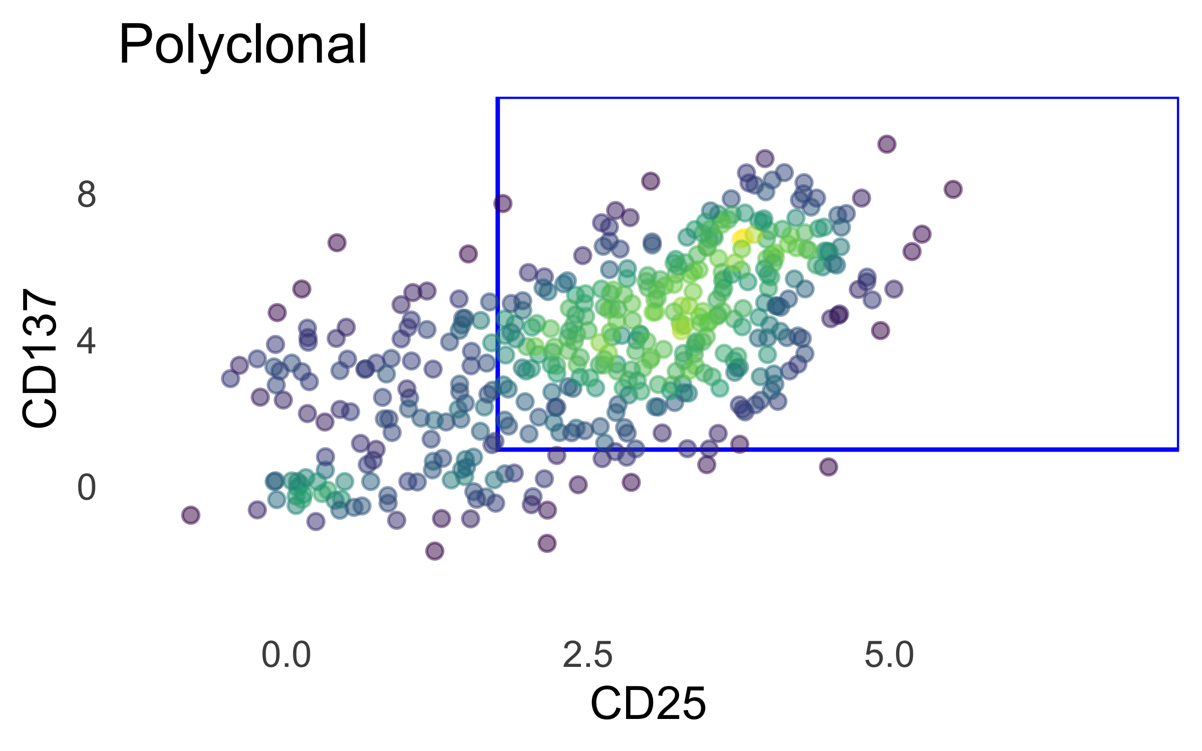
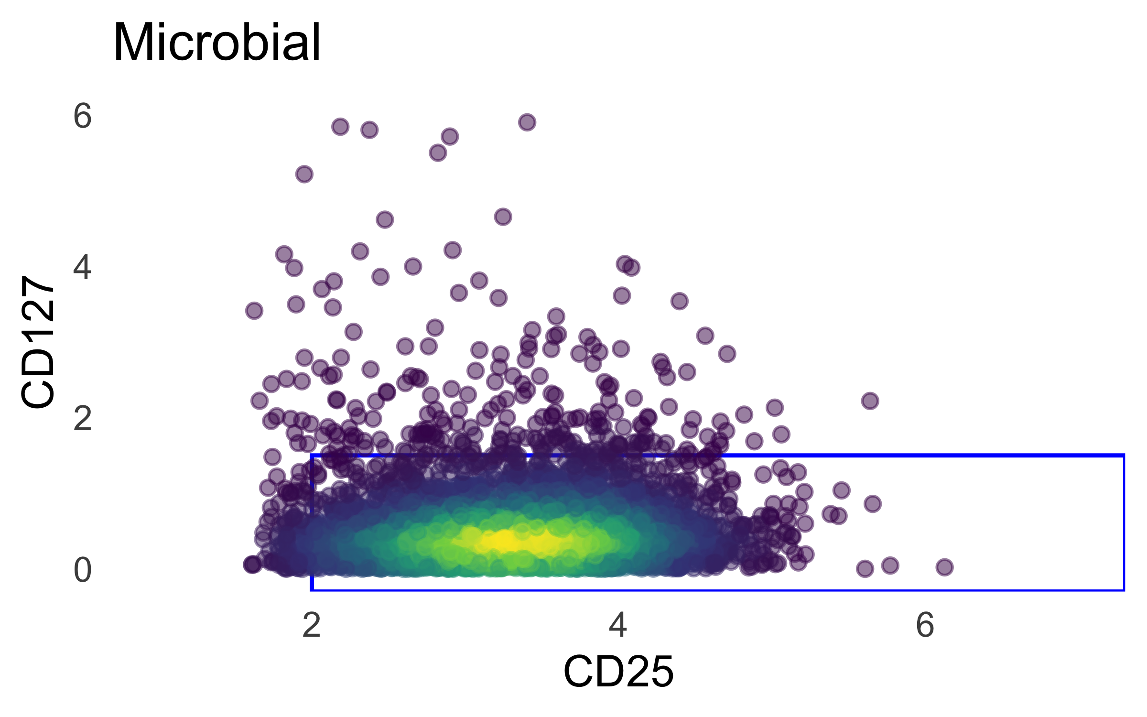
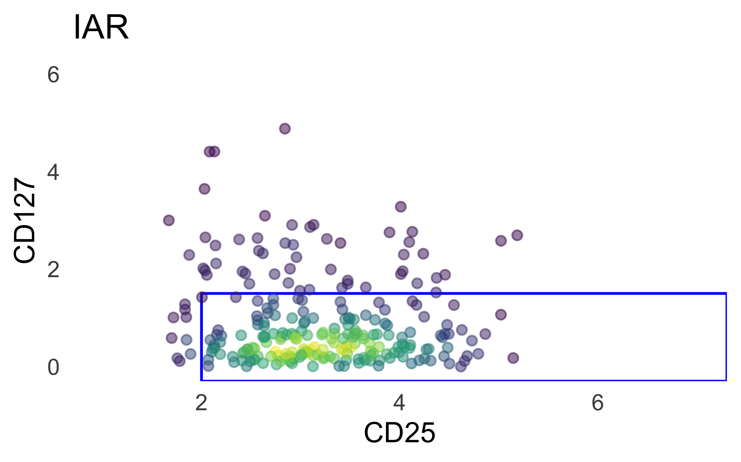
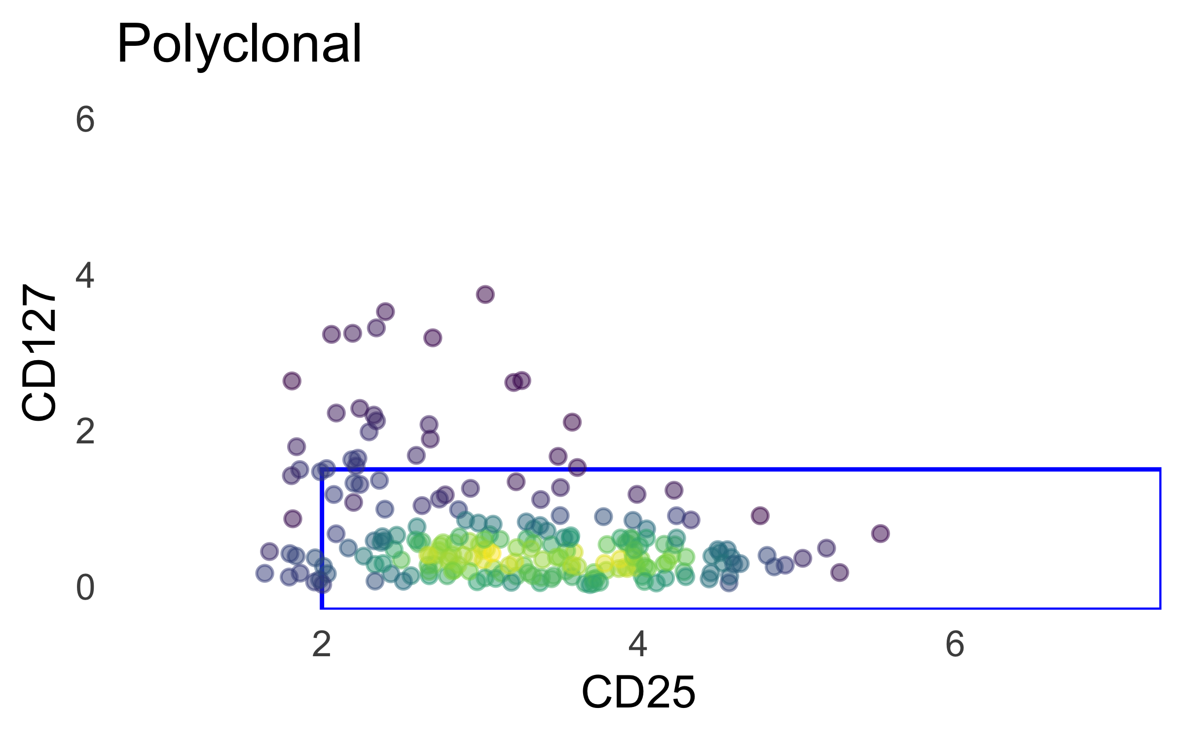
Dsb-norm totalseq gating

Slide 4
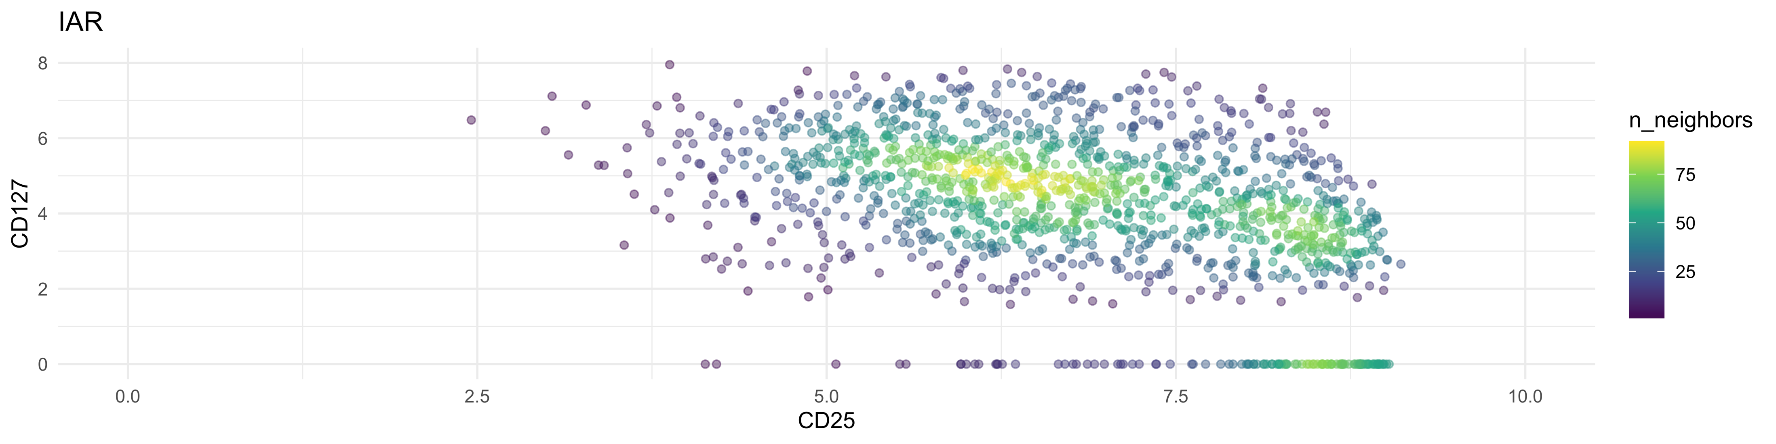
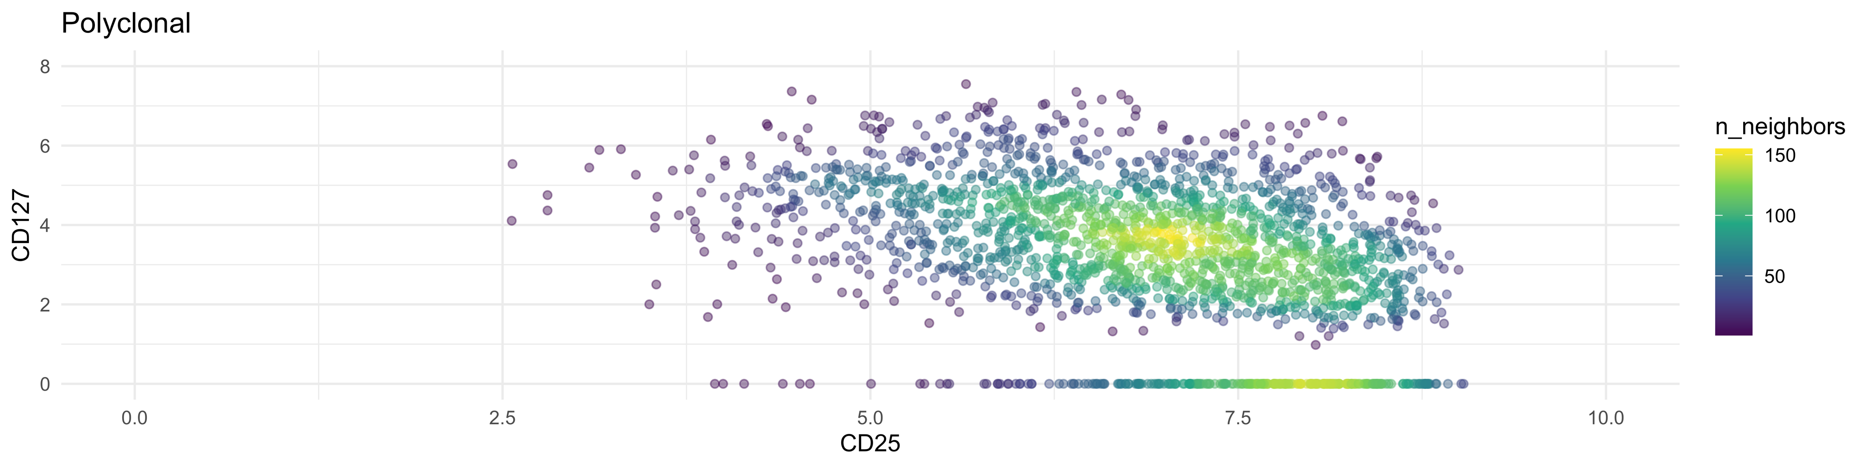
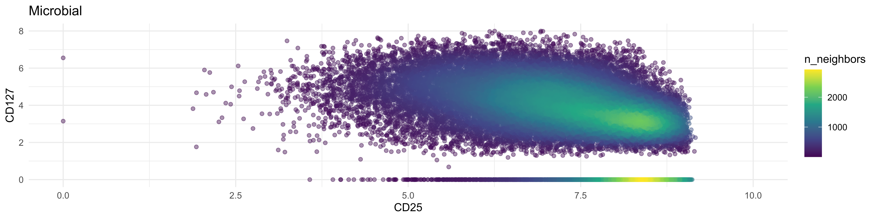

Slide 5
optimized 7-cluster option
Mean scaled cluster eval metric = 0.647/1 (DB, CH, and med. sil. score)

Slide 6
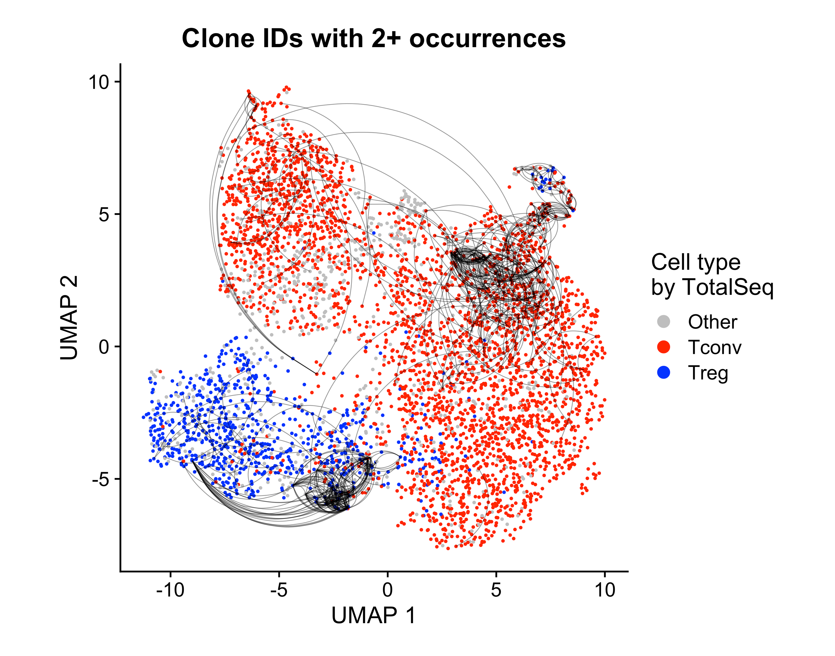
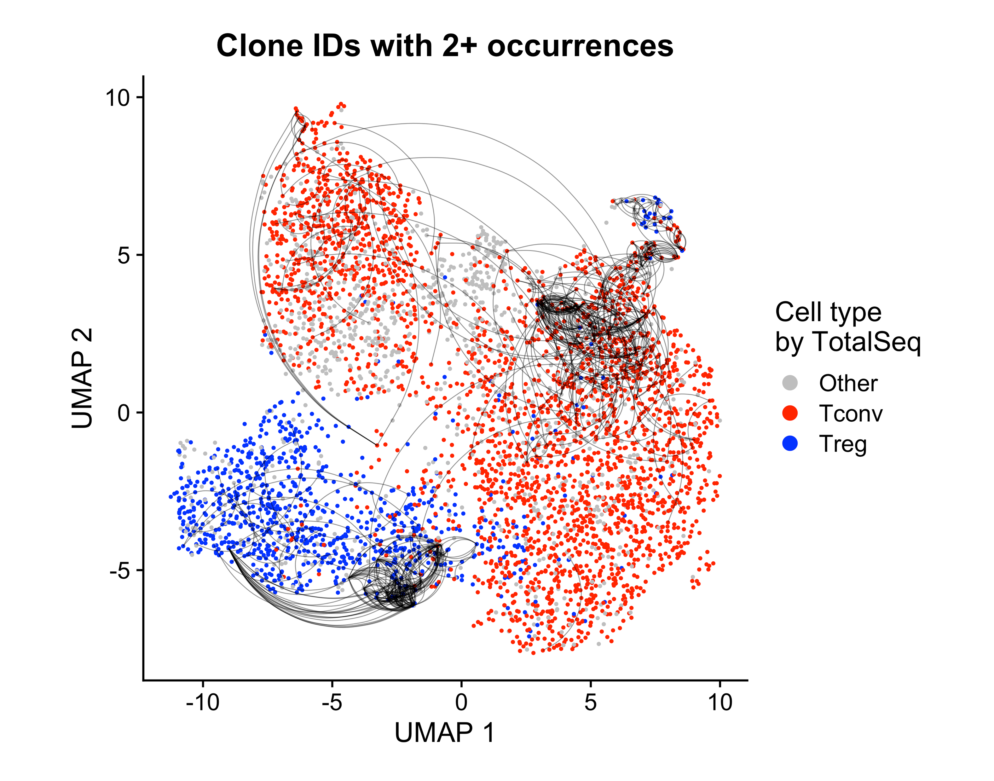
L: lognorm gating, R: dsb gating

Slide 7
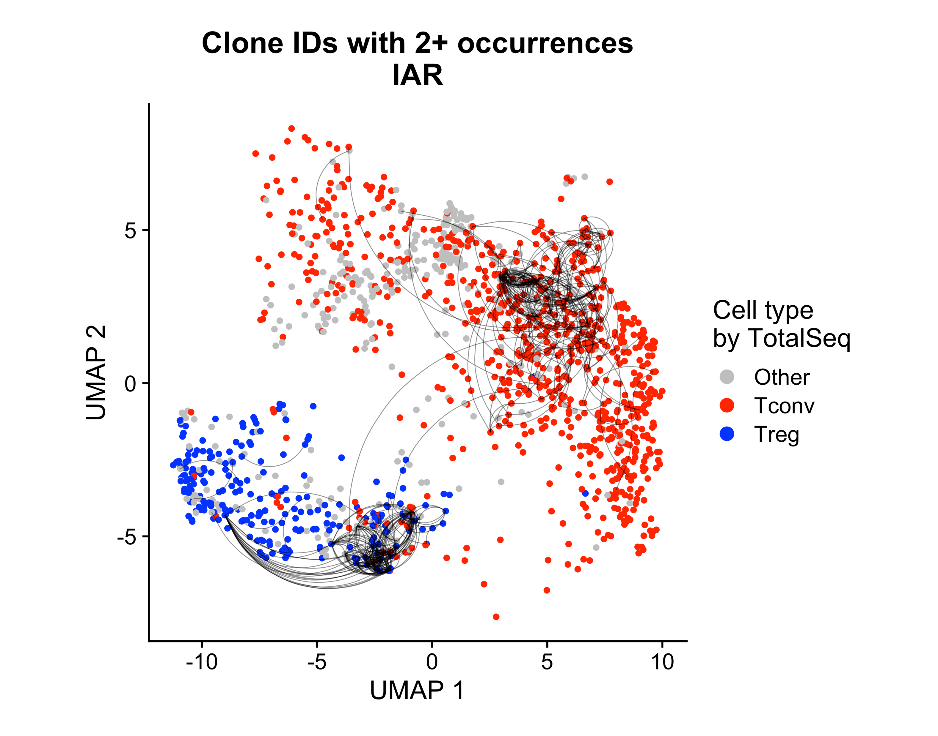
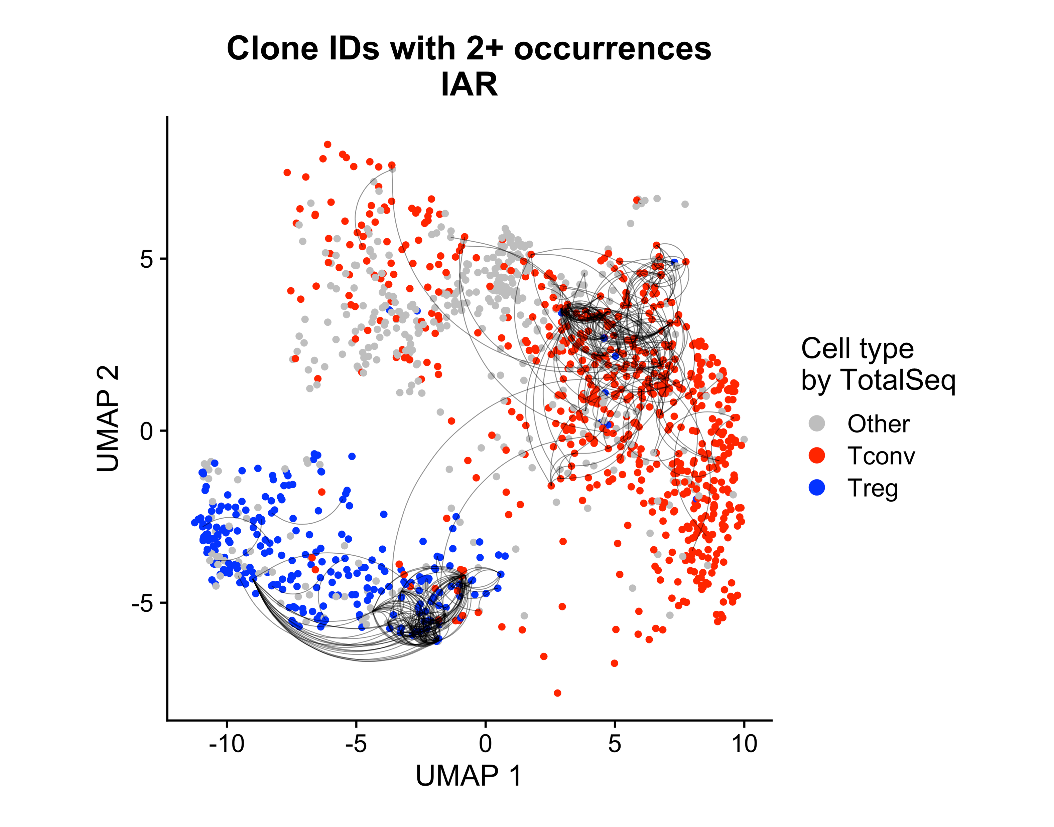
L: lognorm gating, R: dsb gating

Slide 8
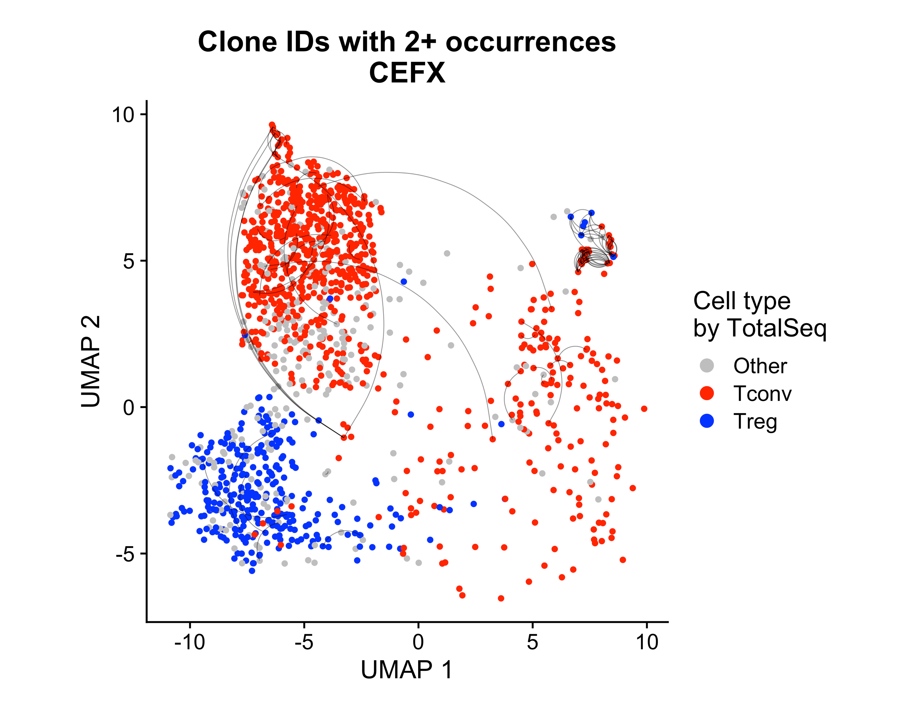
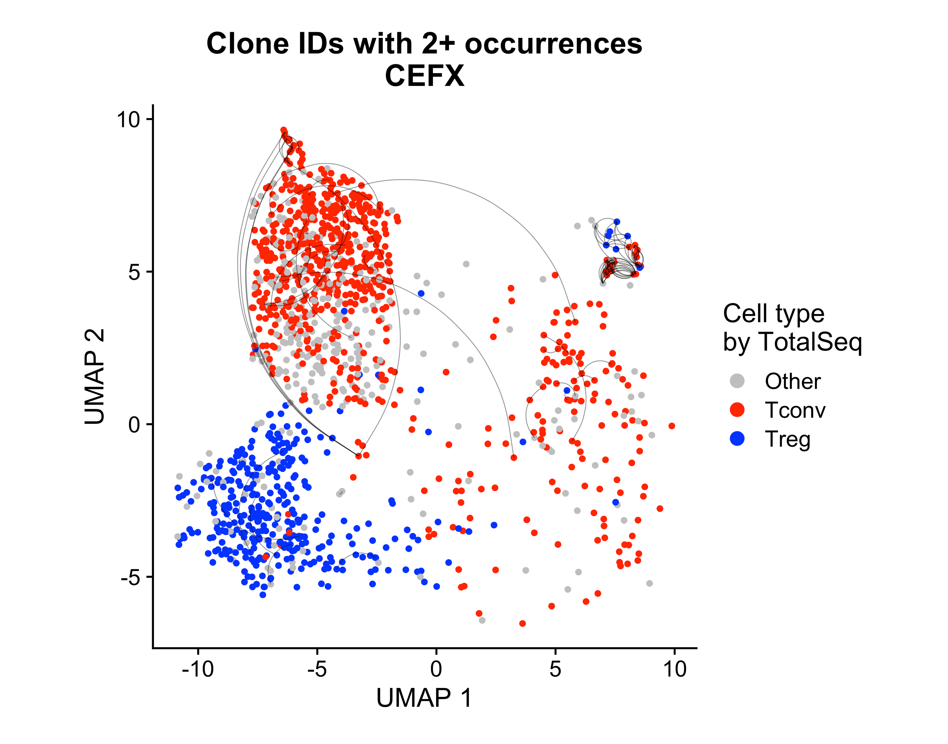
L: lognorm gating, R: dsb gating

Slide 9
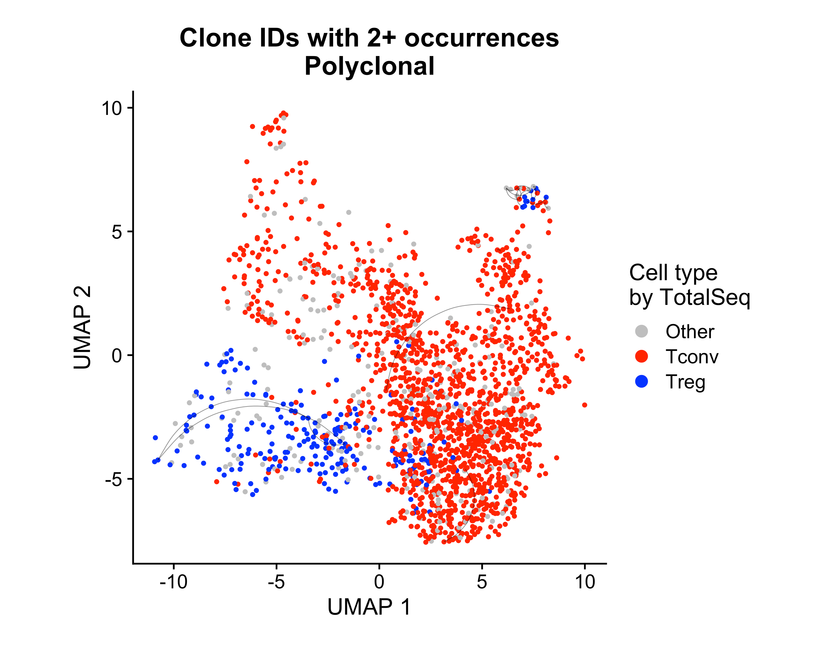
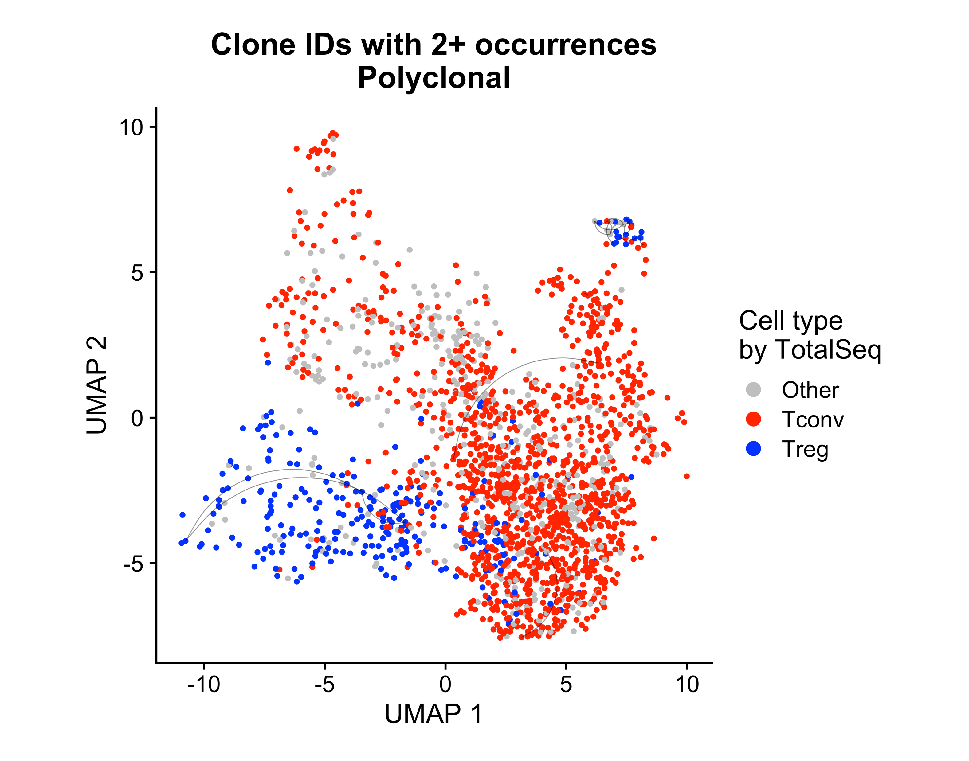
L: lognorm gating, R: dsb gating

Slide 10
optimized 7-cluster option
Mean scaled cluster eval metric = 0.647/1 (DB, CH, and med. sil. score)

Slide 11
7-cluster, stimulation facet

Slide 12
Mean p390 module expression

Slide 13
Celltypist cell calling

Slide 14
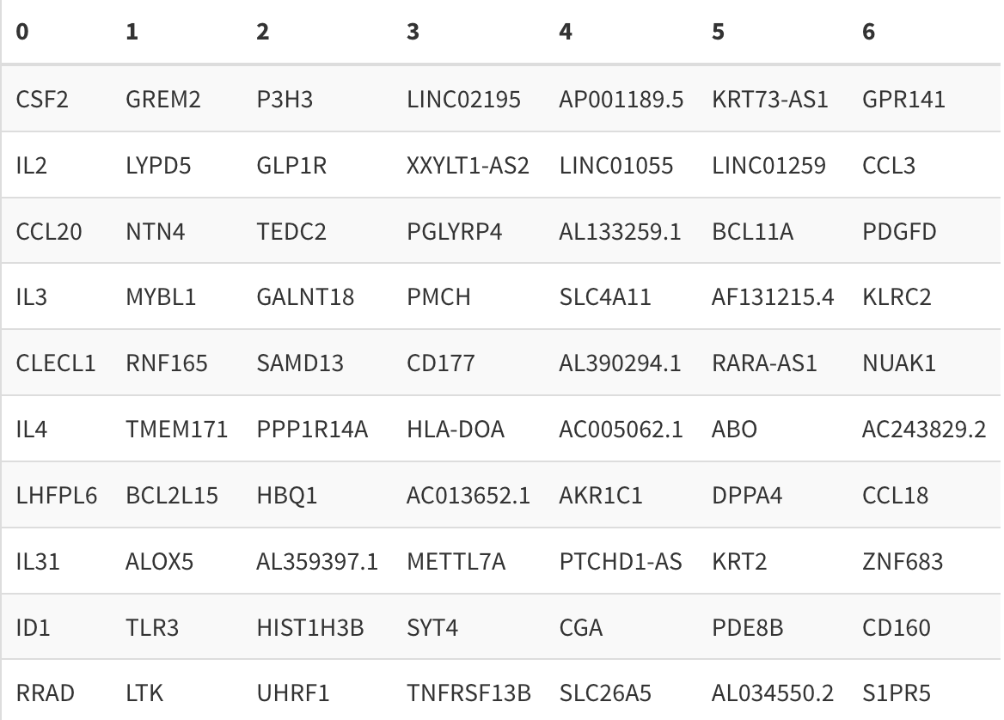
Top 10 cluster-defining genes
Top 10 cluster-defining genes (up relative to other clusters)

Slide 15
Top 10 cluster-defining genes dotplot & diversity metric

Slide 16
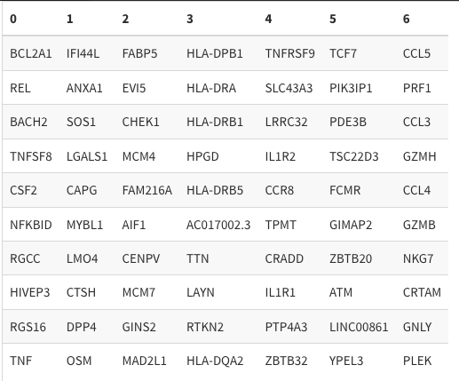
Top 10 cluster-defining genes
Top 10 cluster-defining genes (up relative to other clusters, expressed in at least 30% of cells in that cluster)

Slide 17
Top 10 cluster-defining genes dotplot & diversity metric

Slide 18
Optimized 5-cluster option
Mean scaled cluster eval metric = 0.801/1 (DB, CH, and med. sil. score)

Slide 19
5-cluster, stimulation facet

Slide 20
Mean p390 module expression

Slide 21
Celltypist cell calling

Slide 22
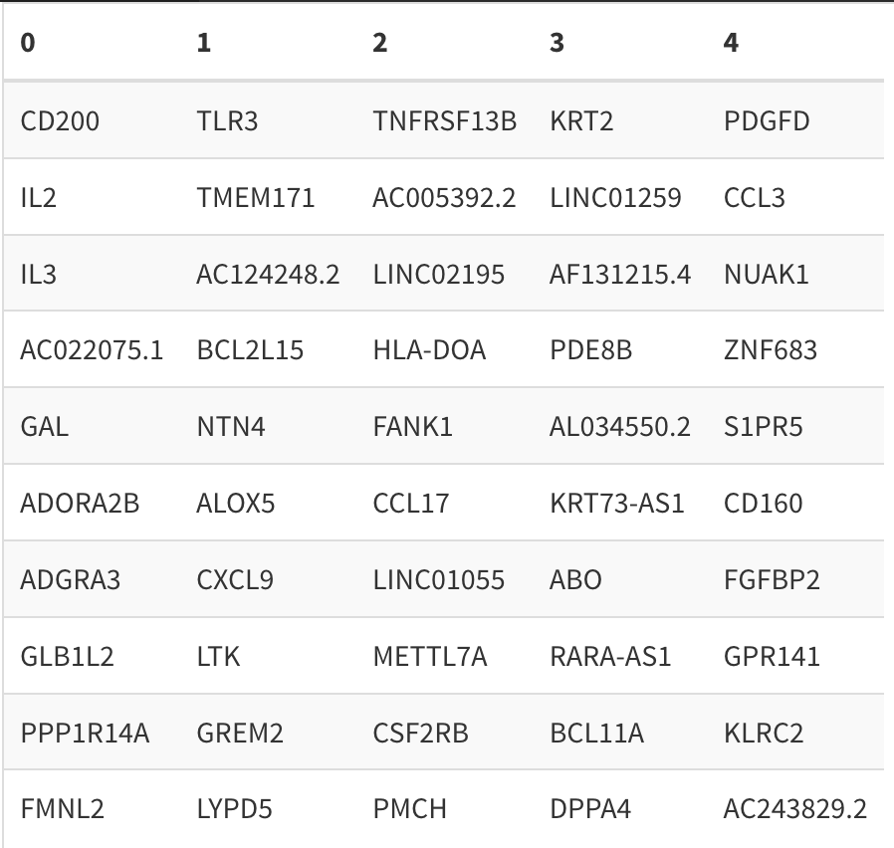
Top 10 cluster-defining genes
Top 10 cluster-defining genes (up relative to other clusters)

Slide 23
Top 10 cluster-defining genes dotplot & diversity metric

Slide 24
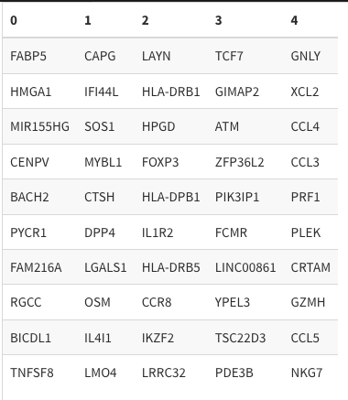
Top 10 cluster-defining genes
Top 10 cluster-defining genes (up relative to other clusters, only genes expressed in at least 30% of cells in that cluster)

Slide 25
Top 10 cluster-defining genes dotplot & diversity metric

